Slide 1
If you haven’t done it yet, please download anaconda

Slide 2
Today’s exercises, answers, and this presentation are in:
https://github.com/JoanaBSilvestre/CodeClub
Download the zip file pressing on the download button

Slide 3
Programming as a concept
Giving instructions to a really really dumb entity

Slide 4


- Beat two whole eggs
Human
Computer

Slide 5
Giving VERY precise instructions and assuming the computer knows nothing

Slide 6
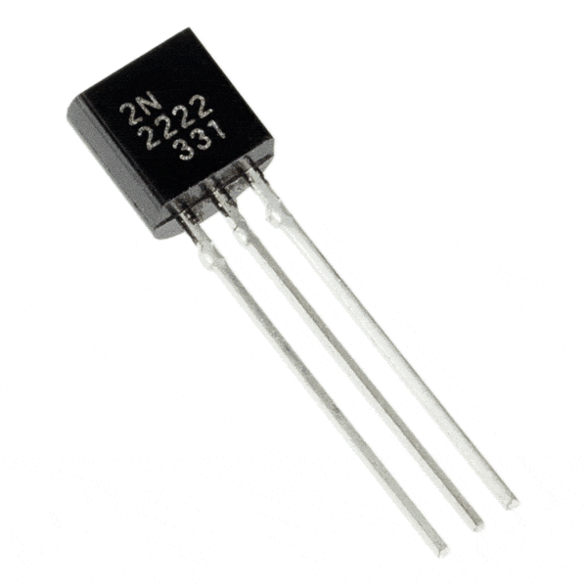
How does the computer do what you want?
Transistor
1
0
This is… binary!

Slide 7

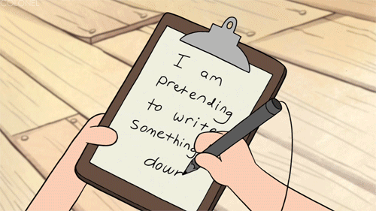
We don’t need to know binary to program
Languages can be
Low level
High level
Closer to the computer
Closer to the humans

Slide 8
There are many computer languages out there
Why choose Python?
The syntax is easy
You can already learn R by consulting the old code club
I like it

Slide 9
Before Python… let’s take a look at your terminal…
Windows: search for cmd, and open command prompt
Mac: go launchpad > other> terminal

Slide 10
Here, things become slightly different..
Mac vs PC
https://ss64.com/bash/
https://ss64.com/nt/

Slide 11


Let’s play with some commands
cal cat cd
clear cp
date ls mkdir
mv pwd rm
CD CLS COPY
DATE DEL DIR
ERASE MD
MOVE NOW
flags: -h -l -a -t -f
?

Slide 12
File structure and how to access them
HOME
aka ~
Documents
Desktop
Downloads
CodeClub
Going up one level: ../
~/Documents/CodeClub

Slide 13
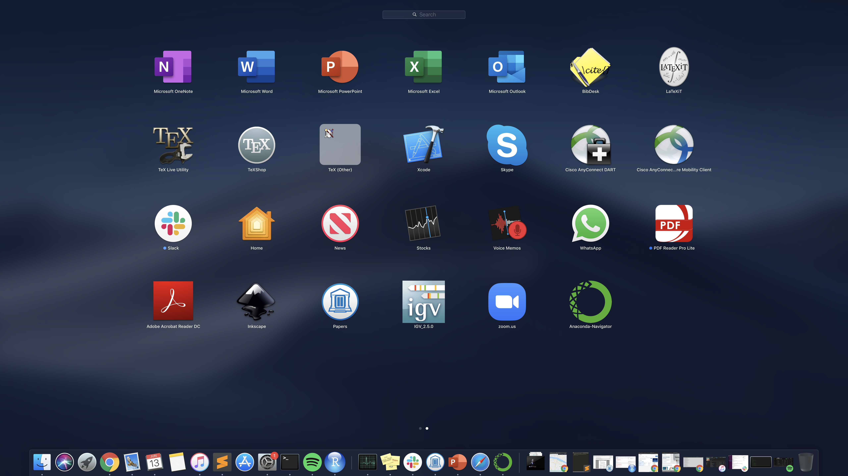
Finally, let’s move to python!
Go to the folder where you have saved the CodeClub folder (the one we downloaded from github)
Use the command line you just learned!
When you get there, type:
jupyter notebook week0_exercise.ipynb
If you want to be faster, type tab after “w”
Easy alternative:

Slide 14
Questions?

